Slide 1
Python - Conditionals
ICT Learning Centre @ UL - Python and ML Foundations

Slide 2
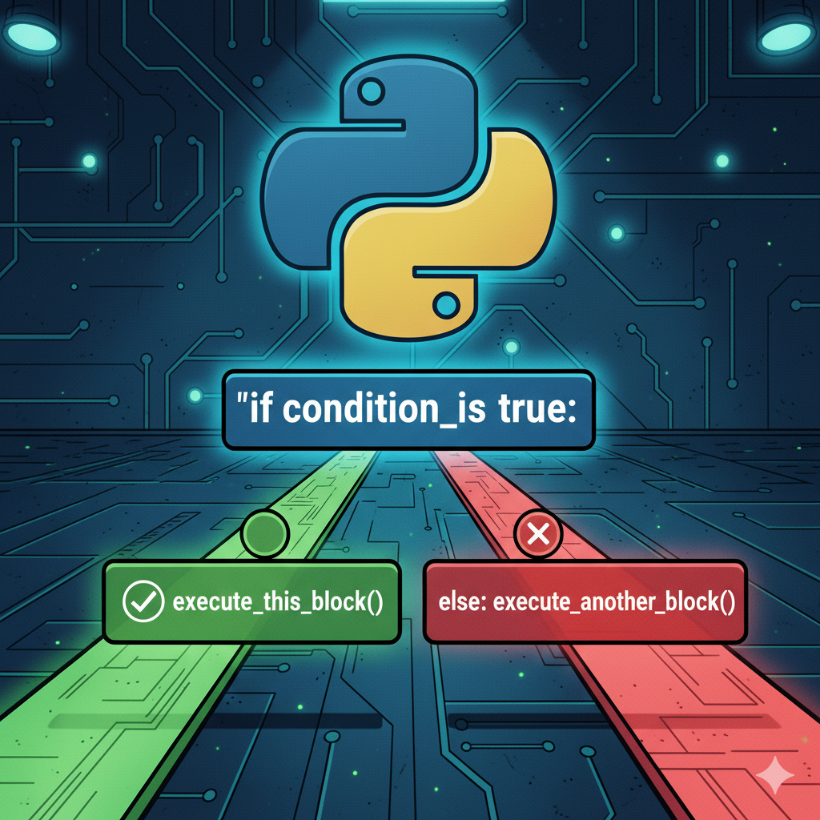
Conditionals
Control flow statements

Slide 3
What are conditionals?
Conditional statements let your program make choices.
Control the ‘flow’ of your code.
Condition
True
False
Do something
Do something else

Slide 4
The if-else statement in Python
For binary decisions i.e., either this or that
Condition
True
False
Do something
Do something else

Slide 5
The if-else statement in Python: Syntax
if <CONDITION>:
# This code runs if condition is True
else:
# This code runs if condition is False
Note: Indentation is crucial!!!

Slide 6
The if-else statement in Python: Example
if score >= 90.0:
print(‘Student has scored A1!’)
else:
print(‘Student has scored a grade below A1.’)

Slide 7
The elif statement in Python
Short for “else if”.
Use to check for multiple conditions in sequence.
Condition 1
True
False
Do something
Condition 2
True
False
Do something
Do something else

Slide 8
The elif statement in Python: Syntax
if <CONDITION_1>:
# This code runs if condition 1 is True
elif <CONDITION_2>:
# This code runs if condition 1 is False but condition 2 is True
else:
# This code runs if all above conditions are false

Slide 9
The elif ladder in Python
if <CONDITION_1>:
# This code runs if condition 1 is True
elif <CONDITION_2>:
# This code runs if condition 1 is False but condition 2 is True
.
.
.
elif <CONDITION_n>:
# This code runs if conditions 1 to n-1 is False but condition n is True
else:
# This code runs if all above conditions are false

Slide 10
Remember: Conditions can be chained
if <CONDITION_1> and <CONDITION_2>:
# This code runs if above expression evaluates to True
elif <CONDITION_3> or <CONDITION_4>:
# This code runs if above expression evaluates to True
else:
# This code runs if condition is False

Slide 11
The match-case statement in Python
Introduced only in Python version 3.10 (2021)
Provides a more elegant syntax for multiple pattern matching over elif ladders.
Match Subject
Case Pattern 1
True
False
Do something
Case Pattern 2
True
False
Do something
Default block

Slide 12
The match-case statement in Python: Syntax
match <SUBJECT>:
case <PATTERN_1>:
# Executes if matches pattern 1
case <PATTERN_n>:
# Executes if matches pattern n
case _:
# Default case executes if all above patterns fail to match

Slide 13
Thank you
ICT Learning Centre,
CS1-046,
CSIS Building,
University of Limerick,
http://ictlc.ul.ie/contactus

